Slide 1
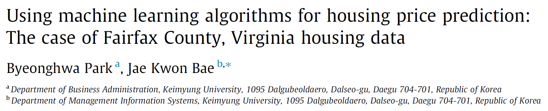
Guang Qiu
11/05/2018

Slide 2
Outlines
Introduction
US Housing price background
Research question: closing price & listing price
Historical housing price prediction models
The use of the hedonic-based regression approach
Artificial intelligence techniques
Experimental design
Data source and selection
Data cleaning and integration
Data extraction, transformation, and reduction
Analysis procedure
Notes:
House price is a significant problem at present. How many of you ever pay attention to US housing price or your home country’s housing price? In China, the housing price is absolutely climbing but slowing down due to government regulation. I thought it was the same tendency in America but actually not.

Slide 3
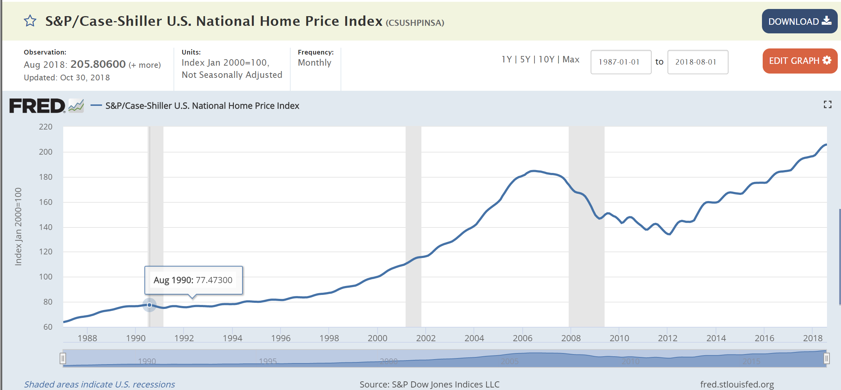
Background: Traditional Reflection for tendency of US housing market
1.Standard & Poor’s Case-Shiller U.S. National Home Price Index
2.housing price index of the Office of Federal Hosing Enterprise Oversight(OFHEO)
Sub-prime mortgage crisis
Inventory of houses
Employment
Notes:
House sales are traditionally determined based on Standard & Poor’s Case-shiller home price index and the housing price index of the Office of Federal Hosing Enterprise Oversight. These reflect the trends of the US housing market. According to this chart, housing prices have declined by approximately 30-60% in major cities in the US since the sub-prime mortgage crisis. Like in Los Angeles and New York, the housing price peaked in 2006 and continued fall until the end of 2011. Beginning in November 2012, the US housing market is experiencing a rapid recovery because of the decreasing inventory of houses, the increasing demand for new houses following employment growth. To sustain the recovery trend of the housing market, timely real estate policies from the government are required. Therefore, housing price indices determining the housing market trend must be researched and developed.

Slide 4
Research question:
*Multiple Listing Service(MLS)
Listing price: the seller originally expects
Closing price: the buyers pay
Whether the closing price was higher or lower than the listing price?
Notes:
So, when a homeowners wish to sell their townhouse, they can be represented by a real estate agent. The agent inputs the information regarding the seller’s house into multiple listing service.

Slide 5
Outlines
Introduction
US Housing price background
Research question: closing price & listing price
Historical housing price prediction models
The use of the hedonic-based regression approach
Artificial intelligence techniques
Experimental design
Data source and selection
Data cleaning and integration
Data extraction, transformation, and reduction
Analysis procedure
Notes:
What can housing price prediction help us? Normally it can greatly assist in the prediction of future housing prices and the establishment of real estate policies. This study uses machine learning algorithms as research methods to develop a housing price prediction model.

Slide 6
Two principal research trends:
The use of the hedonic-based regression approach
Artificial intelligence techniques
Author | Used for
Adair,Berry, & McGreal, 1996; Selim. 2009 | Identify the relationship between house prices and housing characteristics
Meese and Wallace, 2003 | Evaluate the effect of market fundamentals
Bin, 2004 | Measurement and prediction of house price
Kestens, Theriault, and Rosier, 2006 | Measure the heterogeneity of implicit prices
Notes:
Let’s review some background research studies on housing price prediction.

Slide 7
Two principal research trends:
The use of the hedonic-based regression approach
Artificial intelligence techniques
Author | Approches
Kauko, Hooimeijer, and Hakfoort, 2002 | Neural network modeling
Fan et al. , 2006 | Tree-based
Liu, Zhang, and Wu, 2006 | Fuzzy neural network prediction model
Kusan, Aytekin, and Ozdemir, 2010 | Fuzzy logic model
Azadeh, Ziaei, and Moghaddam, 2012 | Hybrid algorithm based on fuzzy linear regression and a fuzzy cognitive map
Gerek, 2014 | Adaptive neuro-fuzzy(ANFIS)
Wang, Wen, Zhang, and Wang, 2014 | Real estate price forecasting models based on particle swarm optimization(PSO) and support vector machine(SVM).
Gu, Zhu, and Jiang, 2011 | A hybrid of genetic algorithm and SVM. (G-SVM)
Notes:
But hedonic-based methods have potential limitations relating to fundamental model assumptions/e some pu shun/ and estimation.

Slide 8
Outlines
Introduction
US Housing price background
Research question: closing price & listing price
Historical housing price prediction models
The use of the hedonic-based regression approach
Artificial intelligence techniques
Experimental design Classification
Data source and selection
Data cleaning and integration
Data extraction, transformation, and reduction
Analysis procedure
Notes:
The experimental design section describes how to establish the experiment in order to test performance of machine learning algorithms for classification.

Slide 9
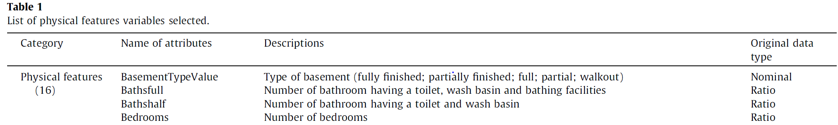
Data source and selection
Sources:
1.MLS (Multiple Listing Service)
2.Historical mortgage rates
3.Public school rating
Period:
January 1, 2004 – May 28, 2007
Size:
15,135 records * 49 attributes(variables) -> preliminary screening
15,135 records * 28 attributes(variables) -> stepwise logistic regression

Slide 10
Data cleaning and integration
Data cleaning:
Missing values
Using other attributes to correct
Remove
Data integration:
By matching attributes

Slide 11
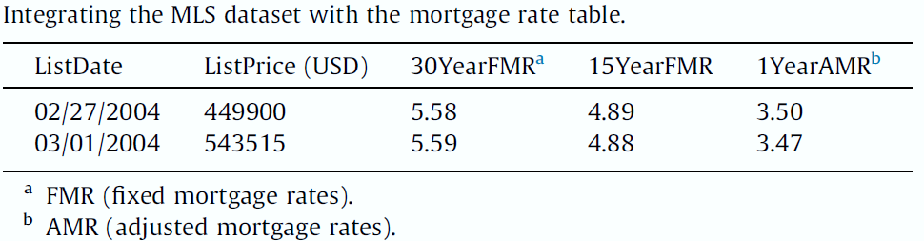
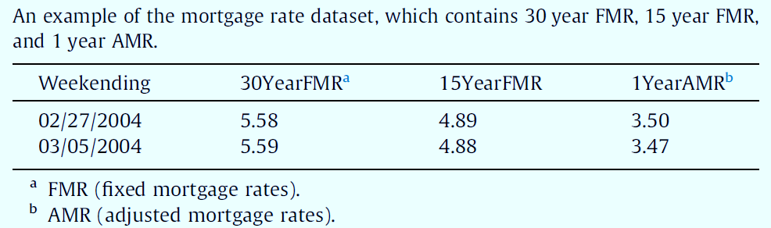
Notes:
There is an example for data integration. In MLS dataset, there is only March first for list data without March fifth, since march 1st is in the week end by march fifth, so it can be integrated.

Slide 12
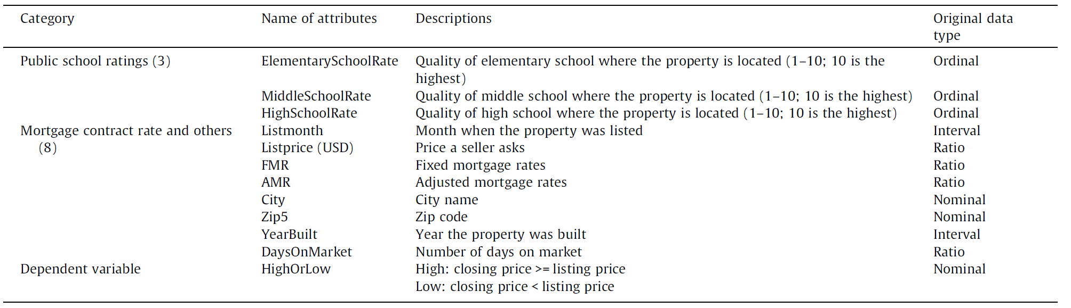
Data extraction, transformation, and reduction

Slide 13
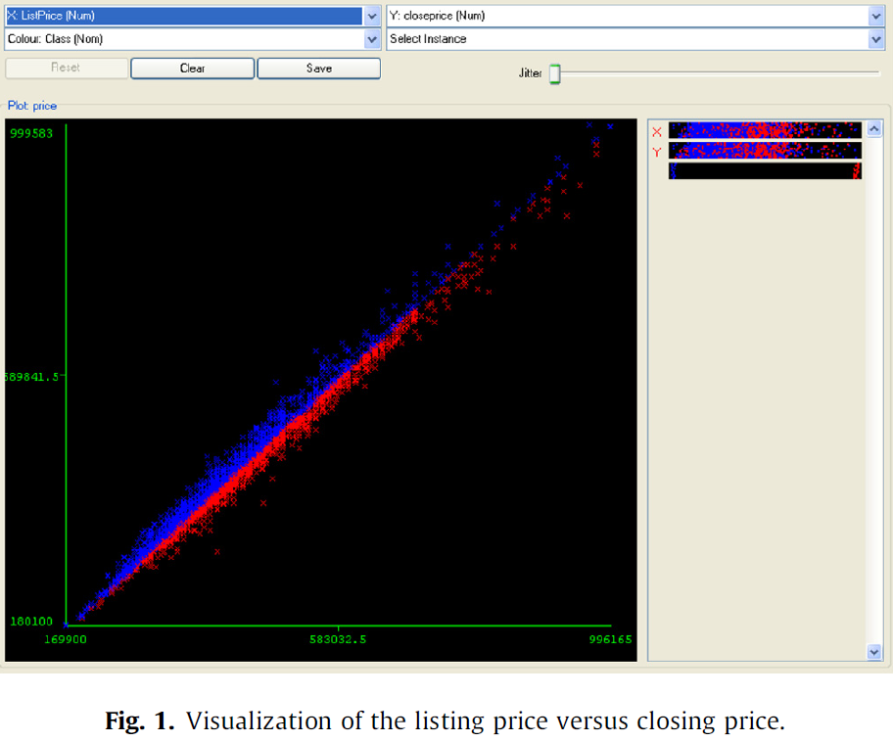
Data extraction, transformation, and reduction
Final dataset: 5359 records
3530 -> high class
1829 -> low class
Notes:
To reduce the size of the dataset, the authors excluded all records that had missing values within the attributes. The final dataset was 5359 records. The blue color represents a higher closing price and the red color a lower closing price than the listing price. Of the 5359 records, 3530 records were high and 1829 were low.

Slide 14
Analysis procedure
Four algorithms & Two methods
C4.5, RIPPER, Naïve Bayesian, AdaBoost
C4.5 is an algorithm used to generate a decision tree developed by Ross Quinlan. C4.5 is an extension of Quinlan's earlier ID3 algorithm. The decision trees generated by C4.5 can be used for classification, and for this reason, C4.5 is often referred to as a statistical classifier.

Slide 15
Analysis procedure
Four algorithms & Two methods
C4.5, RIPPER, Naïve Bayesian, AdaBoost
C4.5 is an algorithm used to generate a decision tree developed by Ross Quinlan. C4.5 is an extension of Quinlan's earlier ID3 algorithm. The decision trees generated by C4.5 can be used for classification, and for this reason, C4.5 is often referred to as a statistical classifier.
RIPPER: Repeated Incremental Pruning to Produce Error Reduction

Slide 16
Analysis procedure
Four algorithms & Two methods
C4.5, RIPPER, Naïve Bayesian, AdaBoost
C4.5 is an algorithm used to generate a decision tree developed by Ross Quinlan. C4.5 is an extension of Quinlan's earlier ID3 algorithm. The decision trees generated by C4.5 can be used for classification, and for this reason, C4.5 is often referred to as a statistical classifier.
RIPPER: Repeated Incremental Pruning to Produce Error Reduction
Naïve Bayesian
Naive Bayes is a simple technique for constructing classifiers: models that assign class labels to problem instances, represented as vectors of feature values, where the class labels are drawn from some finite set. There is not a single algorithm for training such classifiers, but a family of algorithms based on a common principle: all naive Bayes classifiers assume that the value of a particular feature is independent of the value of any other feature, given the class variable.

Slide 17
Analysis procedure
Four algorithms & Two methods
C4.5, RIPPER, Naïve Bayesian, AdaBoost
AdaBoost - Background
AdaBoost, short for Adaptive Boosting, is a machine learning meta-algorithm formulated by Yoav Freund and Robert Schapire, who won the 2003 Gödel Prize for their work. It can be used in conjunction with many other types of learning algorithms to improve performance. The output of the other learning algorithms ('weak learners') is combined into a weighted sum that represents the final output of the boosted classifier. AdaBoost is adaptive in the sense that subsequent weak learners are tweaked in favor of those instances misclassified by previous classifiers. AdaBoost is sensitive to noisy data and outliers. In some problems it can be less susceptible to the overfitting problem than other learning algorithms. The individual learners can be weak, but as long as the performance of each one is slightly better than random guessing, the final model can be proven to converge to a strong learner.

Slide 18
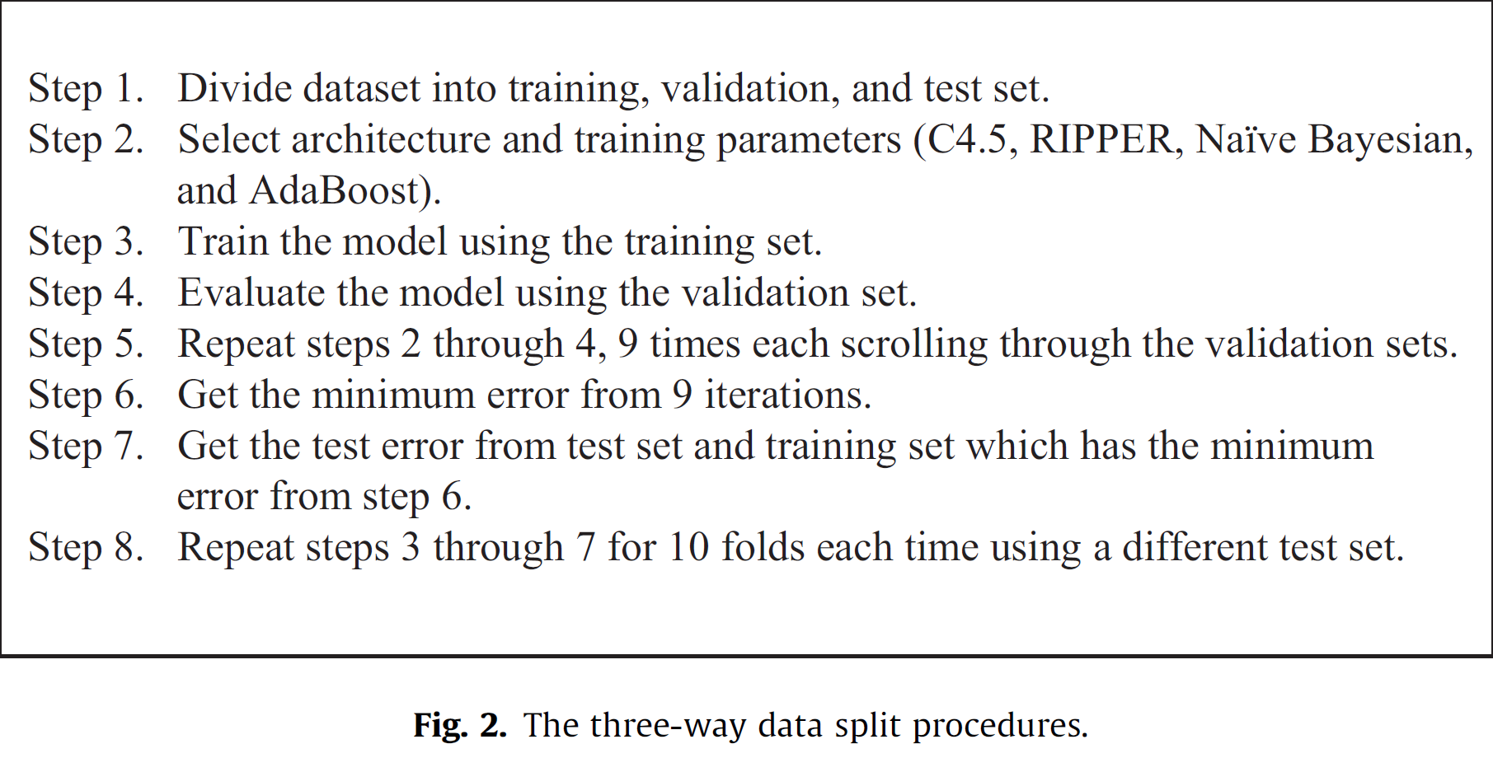
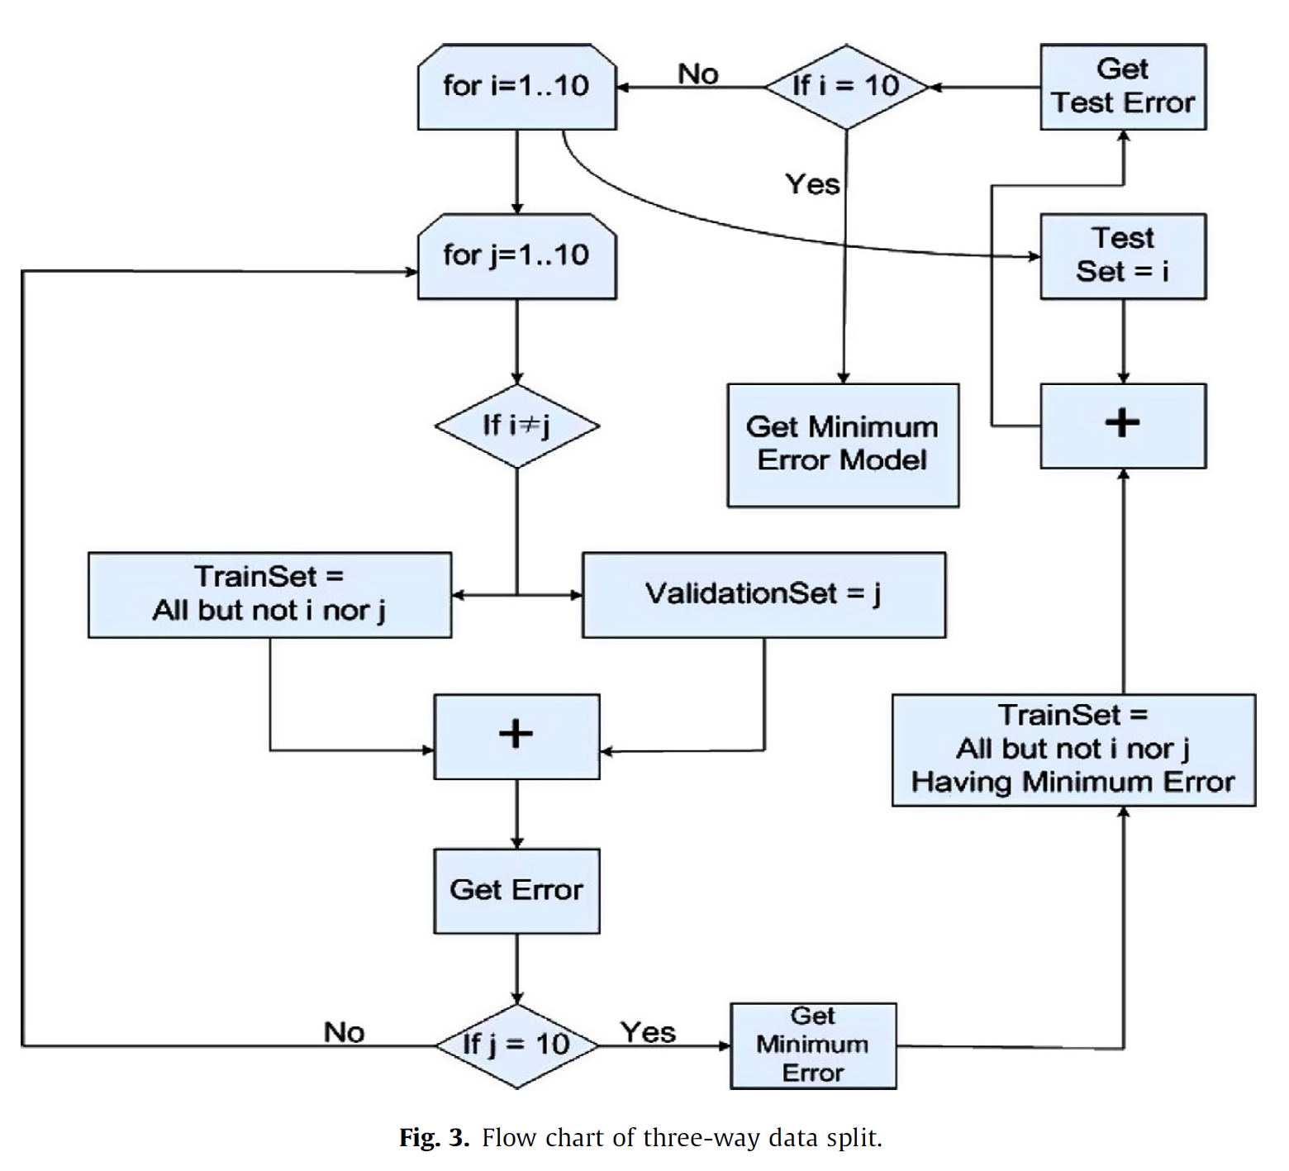
Analysis procedure
Four algorithms & Two methods
Three-way split with 10-folds & 10-fold cross-validation
5359 records:
Nine groups:9 * 536 records
Last group: 535 records

Slide 19
Analysis procedure
Four algorithms & Two methods
Three-way split with 10-folds & 10-fold cross-validation
90 testing combinations
**The three way split processed the ten folds where each one included the combinations of one test set and one of the remaining nine validation sets. And the other 8 remaining were the training sets.
10 combinations
The 10-fold cross-validation used only one test set and the remaining nine training sets.

Slide 20
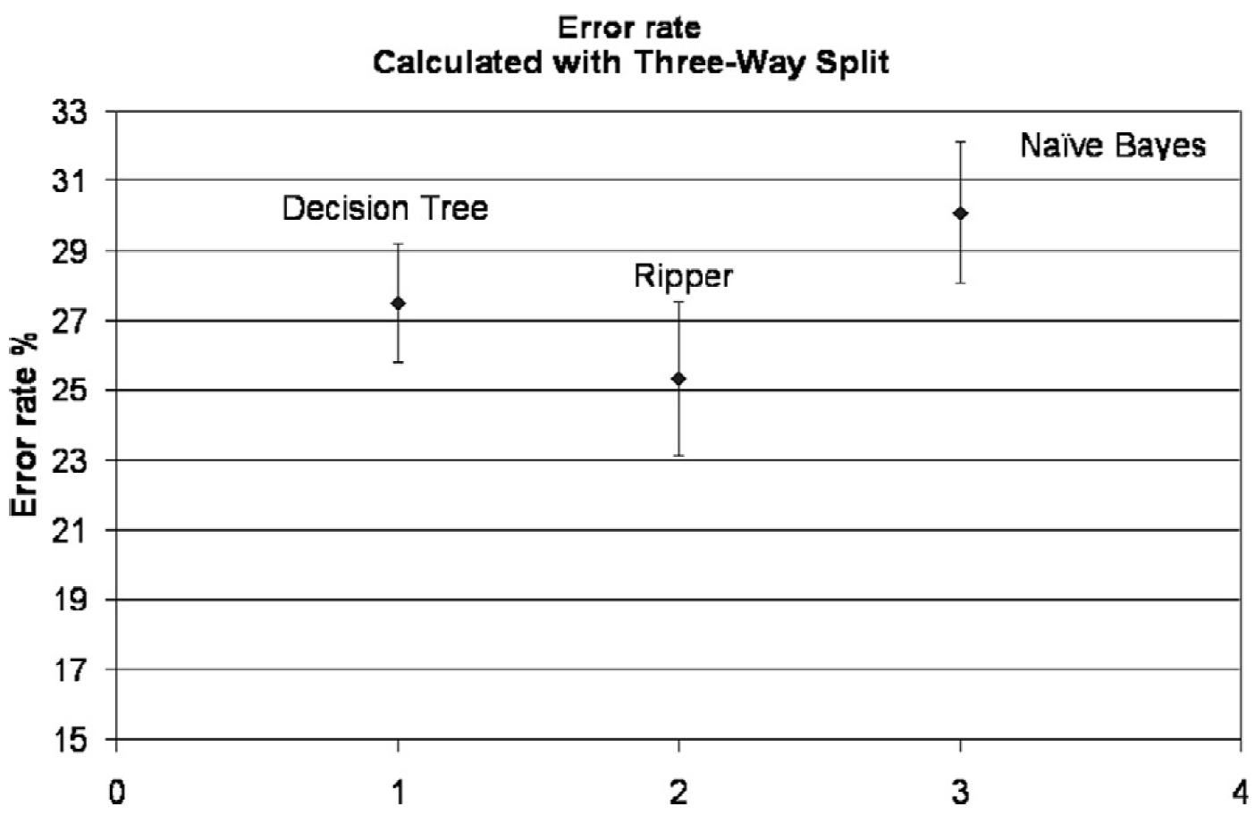
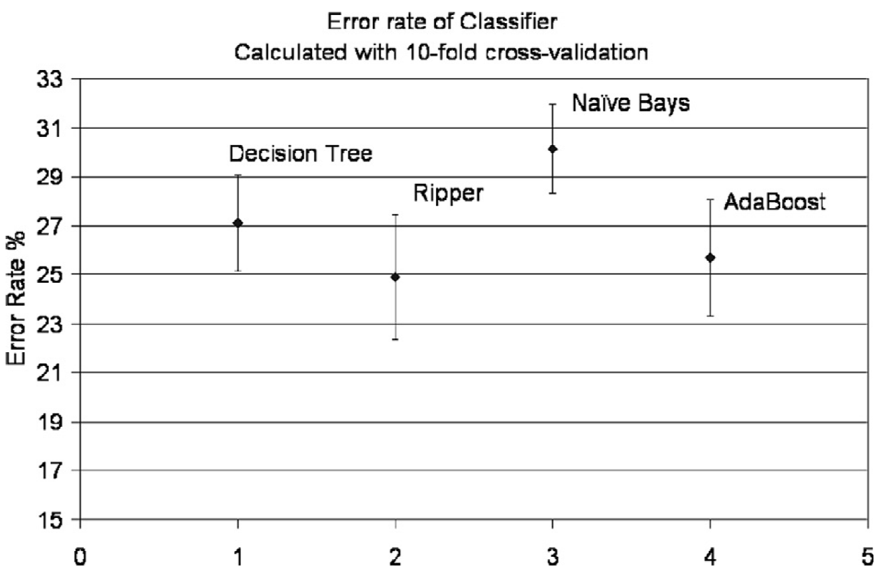
Experimental results
Three-way split with 10-folds & 10-fold cross-validation

Slide 21
Conclusion
RIPPER is superior to that of the C4.5, Naïve Bayesian, and AdaBoost models.
Previous studies -> hedonic-based methods (Limitation of assumptions and estimations)
Recent research -> compare conventional ways with machine learning approaches
This study -> compares the performance of various classifier in machine learning algorithms

Slide 22
Limitations of this study
Conclusion
RIPPER is superior to that of the C4.5, Naïve Bayesian, and AdaBoost models.
Previous studies -> hedonic-based methods (Limitation of assumptions and estimations)
Recent research -> compare conventional ways with machine learning approaches
This study -> compares the performance of various classifier in machine learning algorithms
Specific region - Fairfax County
Specific type of residential properties - townhouses

Slide 23
References
Adair, A., Berry, J., & McGreal, W. (1996). Hedonic modeling, housing submarkets and residential valuation. Journal of Property Research, 13(1), 67–83.
Azadeh, A., Ziaei, B., & Moghaddam, M. (2012). A hybrid fuzzy regression-fuzzy cognitive map algorithm for forecasting and optimization of housing market fluctuations. Expert Systems with Applications, 39(1), 298–315.
Bin, O. (2004). A prediction comparison of housing sales prices by parametric versus semi-parametric regressions. Journal of Housing Economics, 13, 68–84.
Eichholtz, P., Veld, H. O., & Schweitzer, M. (2000). REIT performance. Does managerial specialization pay? In P. T. Harker & S. A. Zenios (Eds.), Performance of financial institutions: Efficiency, innovation, regulation (pp. 199–220). New York: Cambridge University Press.
Fan, G., Ong, Z. S. E., & Koh, H. C. (2006). Determinants of house price. A decision tree approach. Urban Studies, 43(12), 2301–2315.
Gerek, L. H. (2014). House selling price assessment using two different adaptive neuro-fuzzy techniques. Automation in Construction, 41, 33–39.

